Slide 1
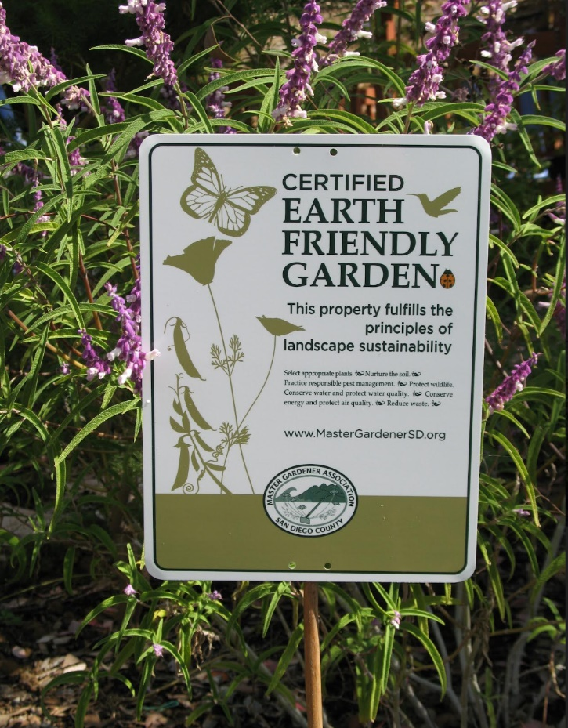
Certified Earth-Friendly Gardens
Sustainable landscaping practices that are not harmful to people, native plants, animals, and the overall environment

Slide 2
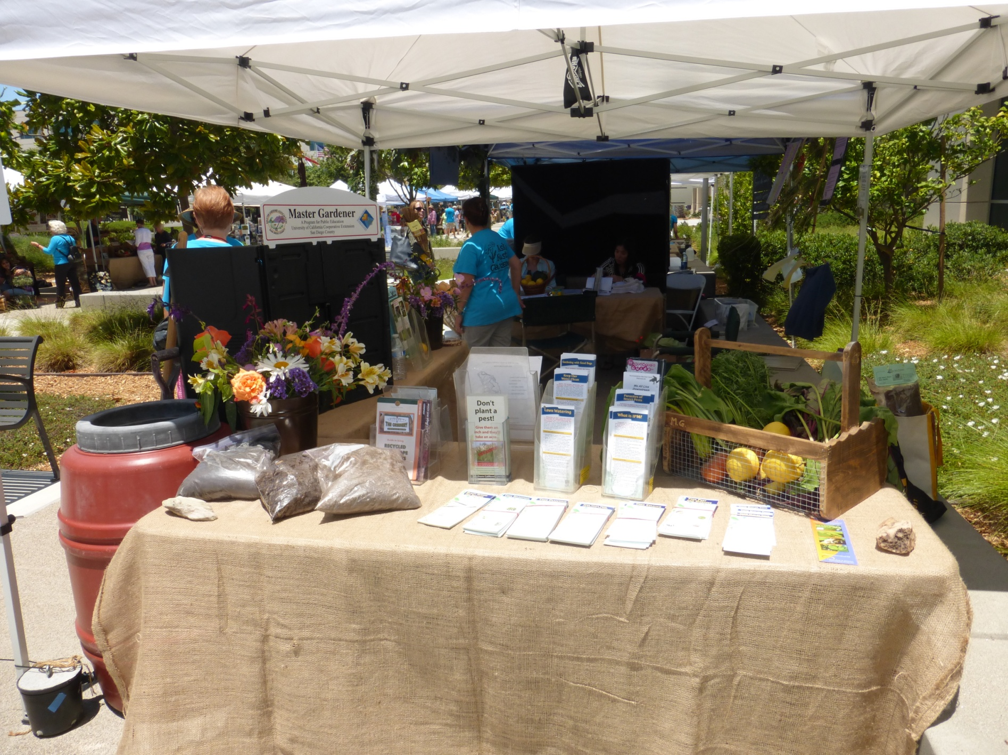
Table at Events

Slide 3
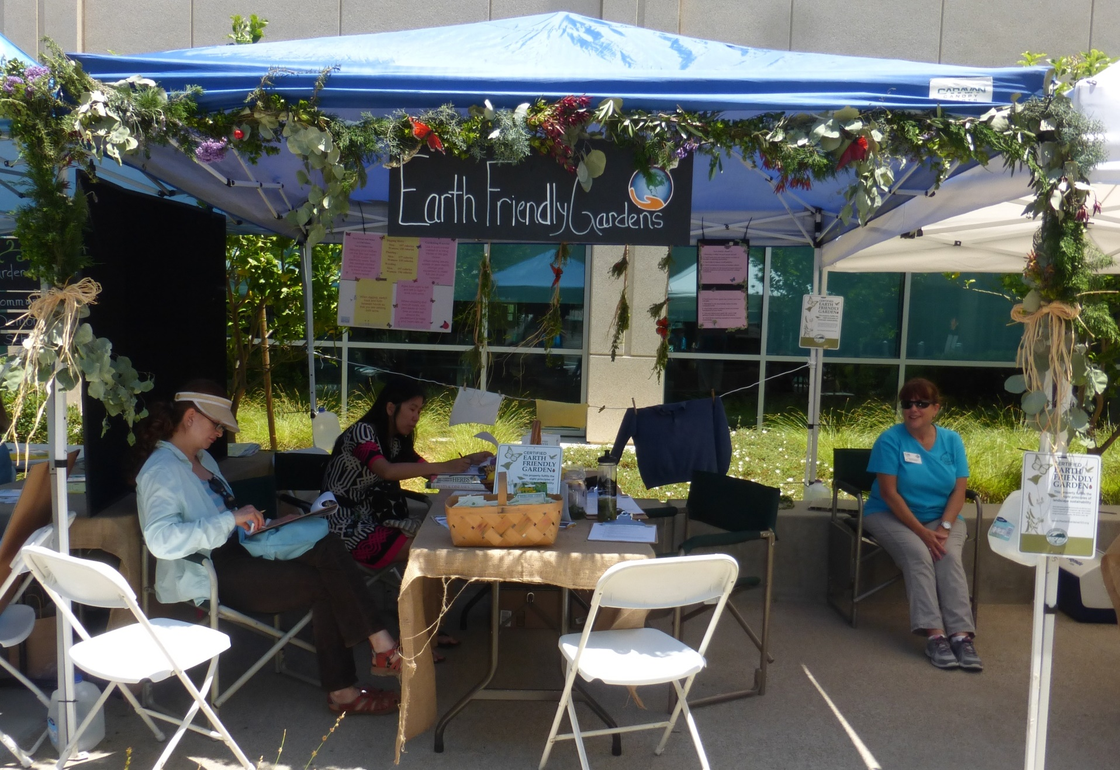
Spring Seminar Booth

Slide 4
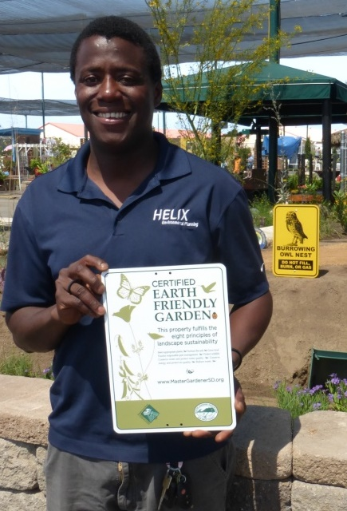
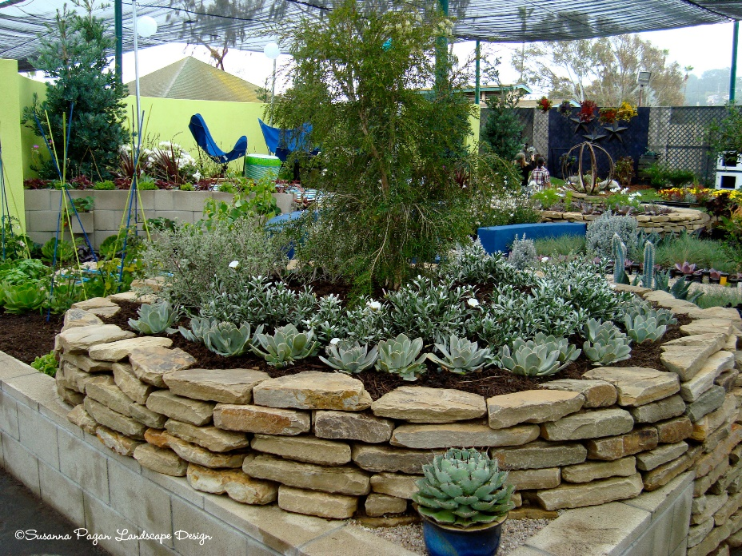
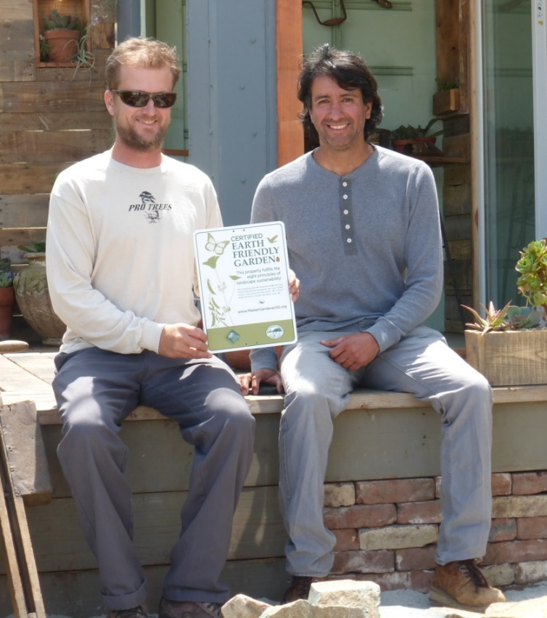
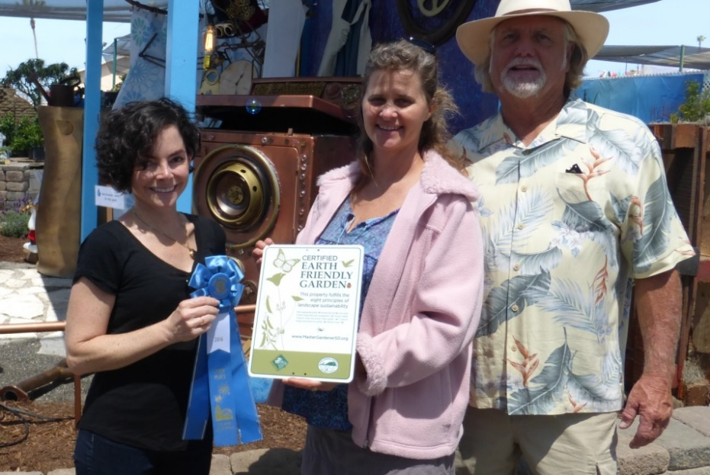
Earth-Friendly Awards at the
San Diego County Fair
Notes:
https://c2.staticflickr.com/4/3084/2725850059_85d8c6a247.jpg

Slide 5
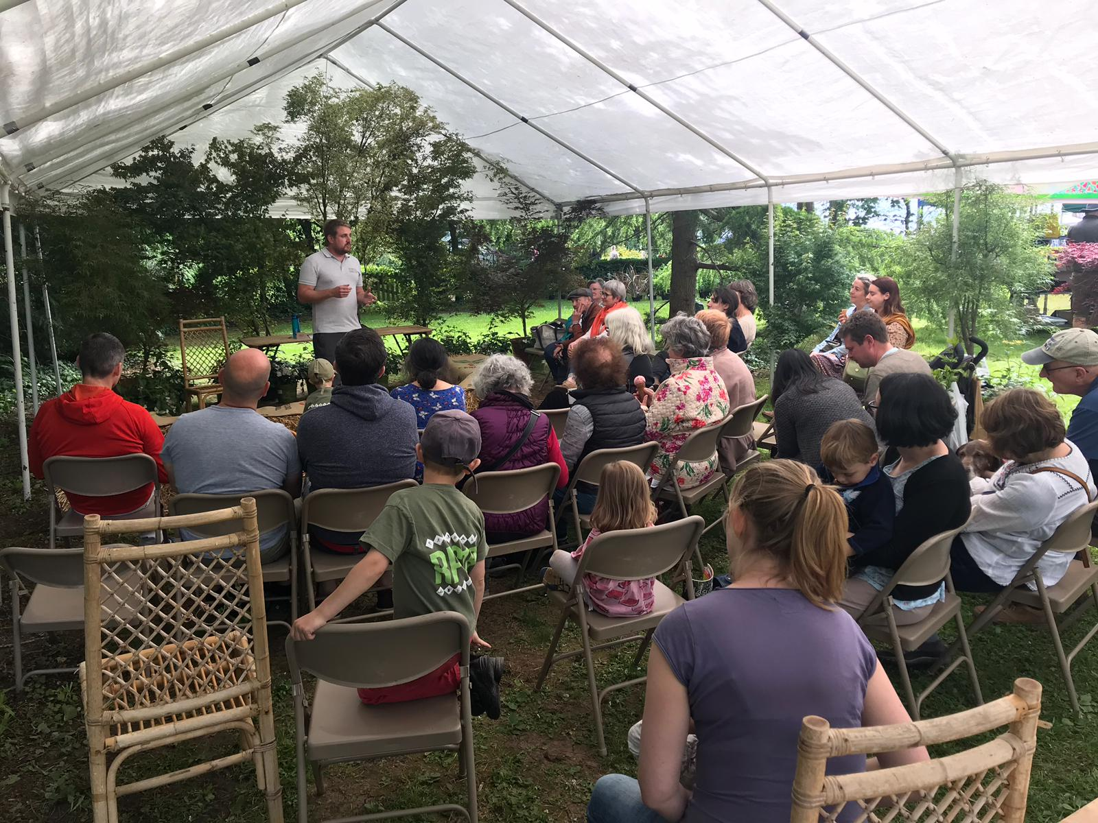
Earth-Friendly Talks to Garden Clubs
Notes:
http://www.englishhomestead.com/p/garden-club-talks.html

Slide 6
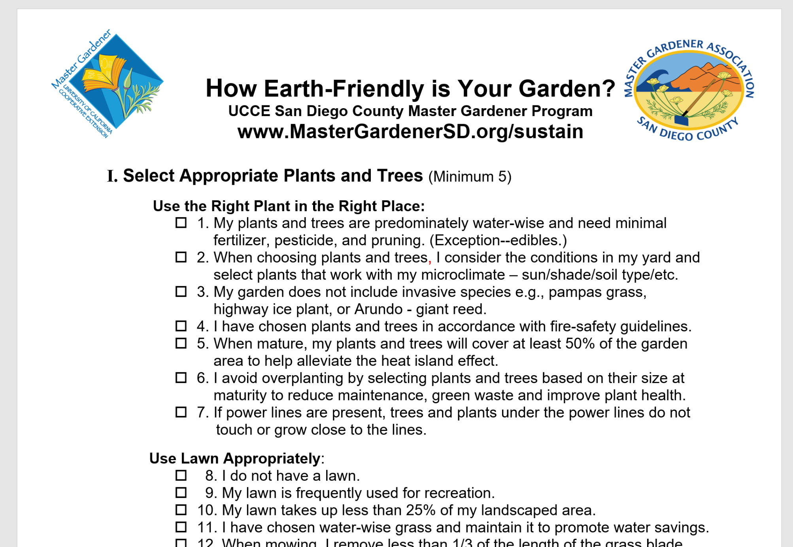
Printed checklist:

Slide 7
Also available online
https://www.mastergardenersd.org/

Slide 8
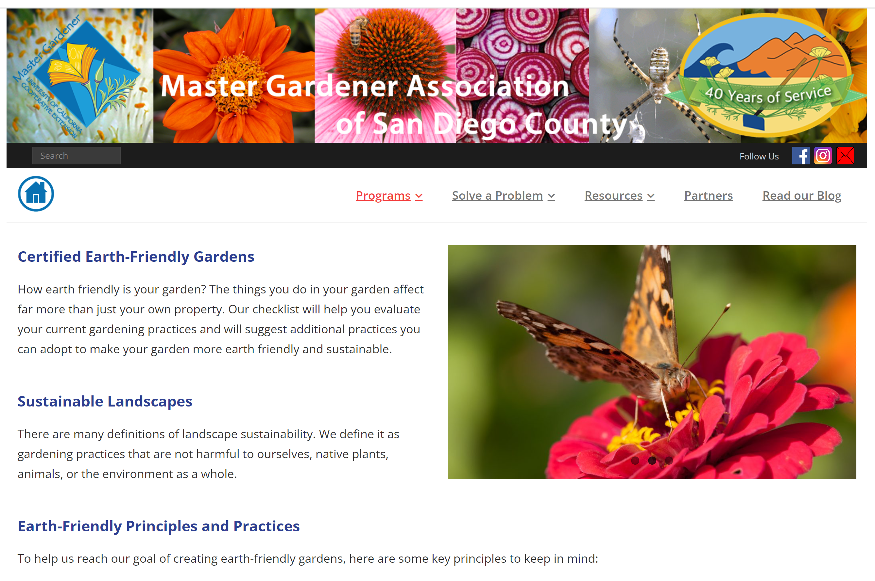
https://www.mastergardenersd.org/earth-friendly-gardens/

Slide 9
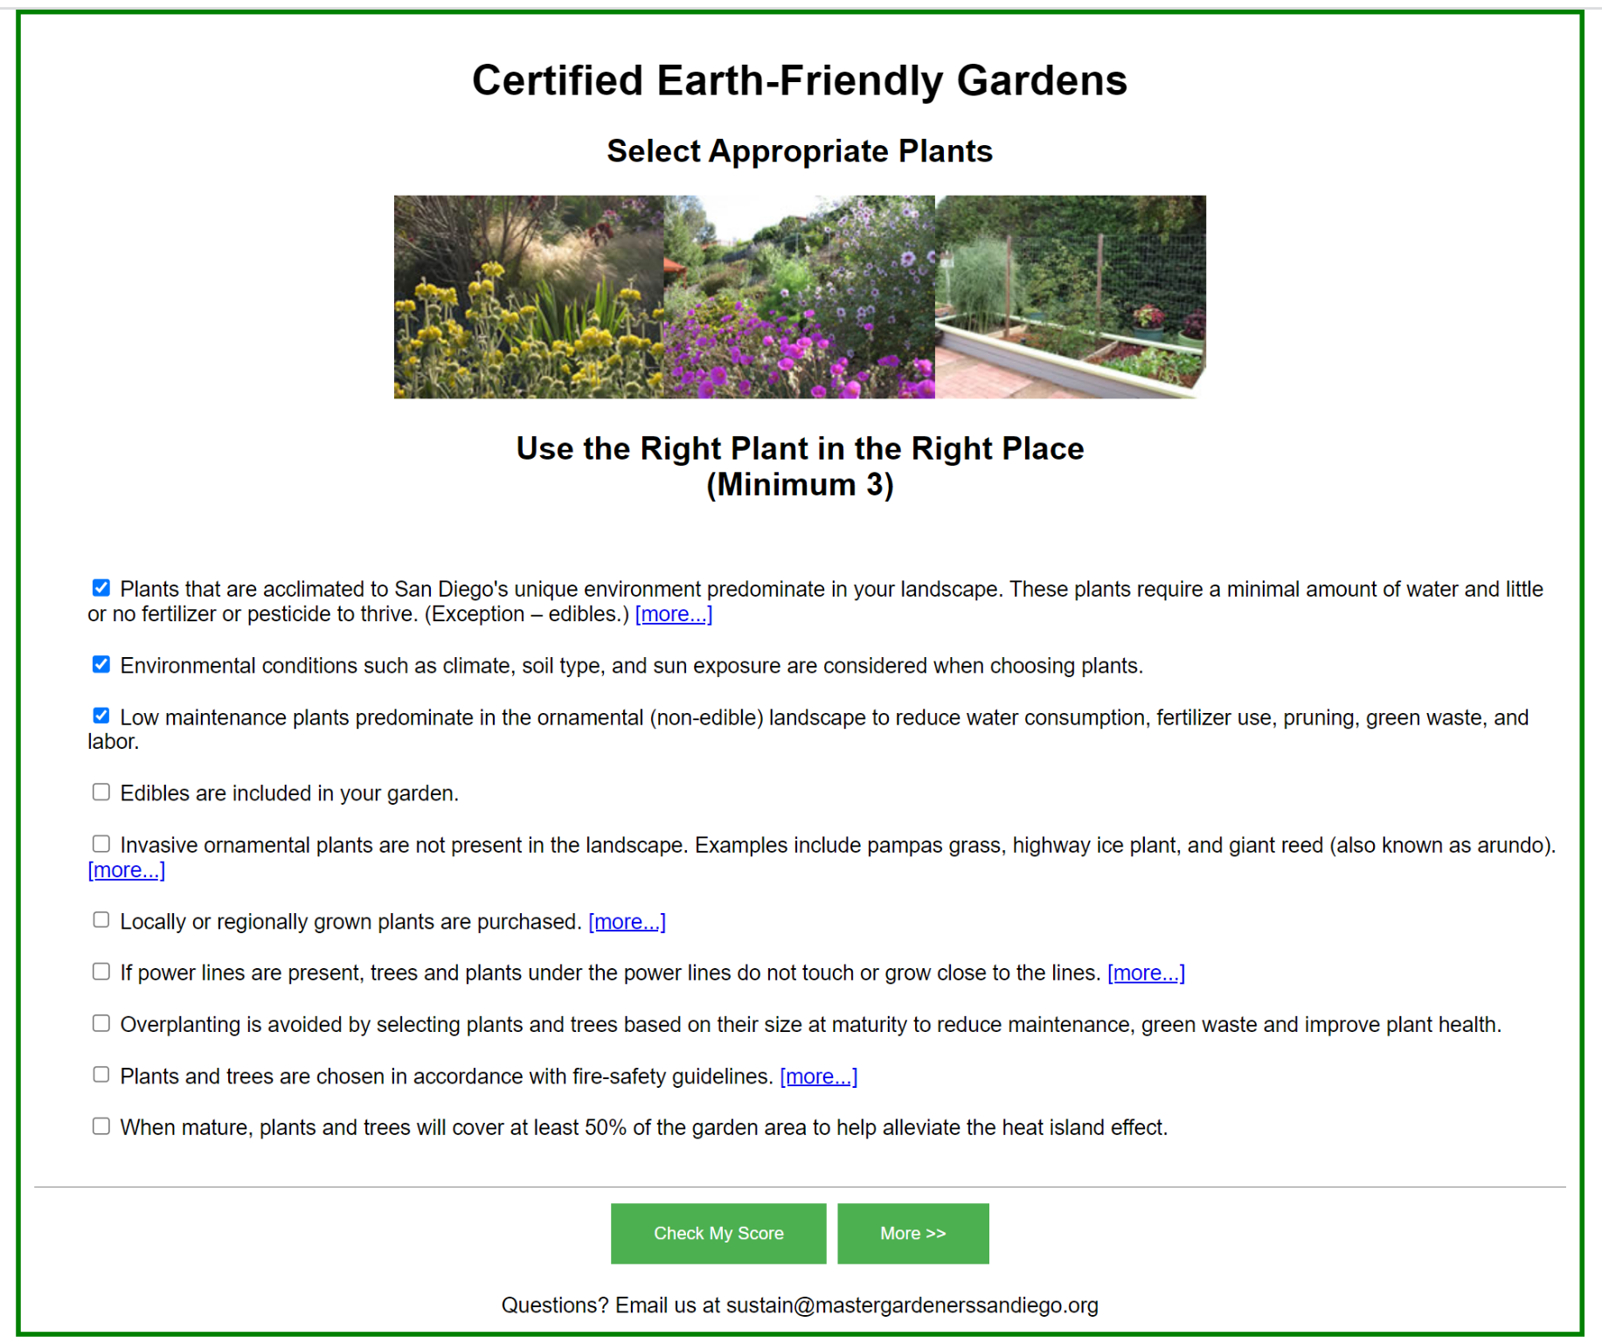
Check off at least the minimum number of boxes on each page:

Slide 10
Scroll down to the bottom of the page:

Slide 11
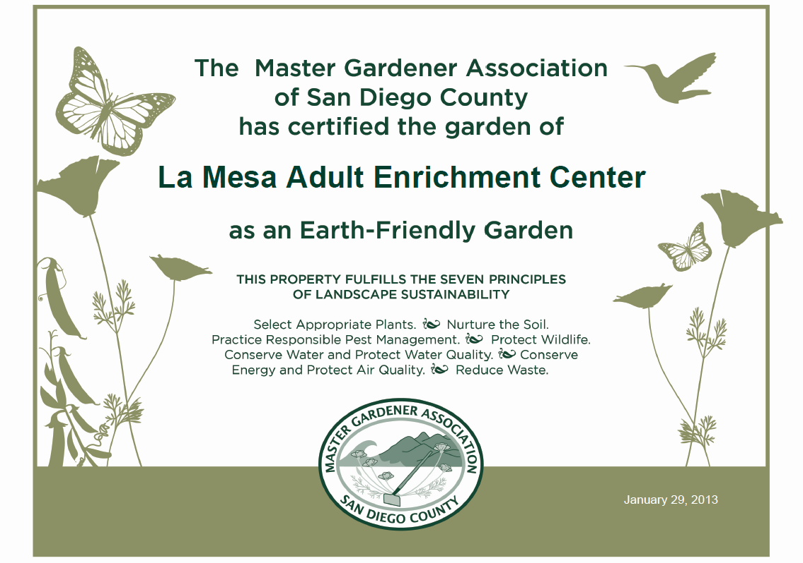

Slide 12
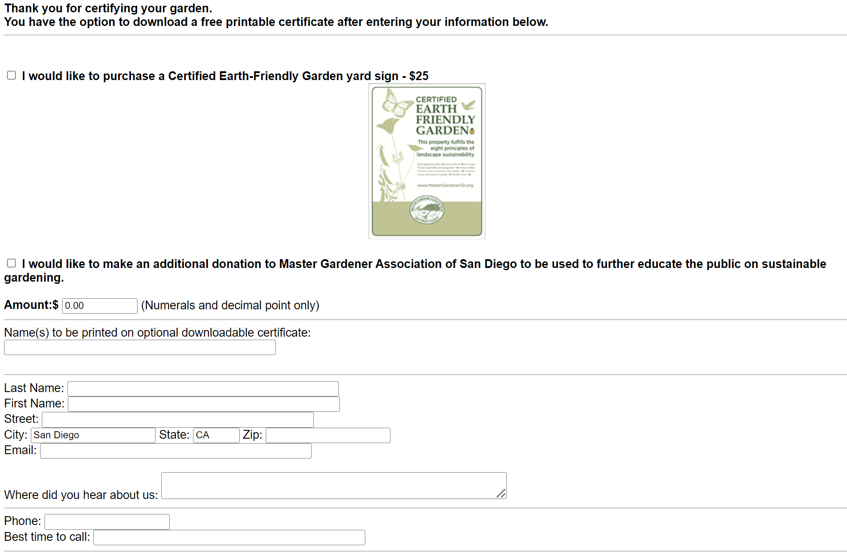

Slide 13
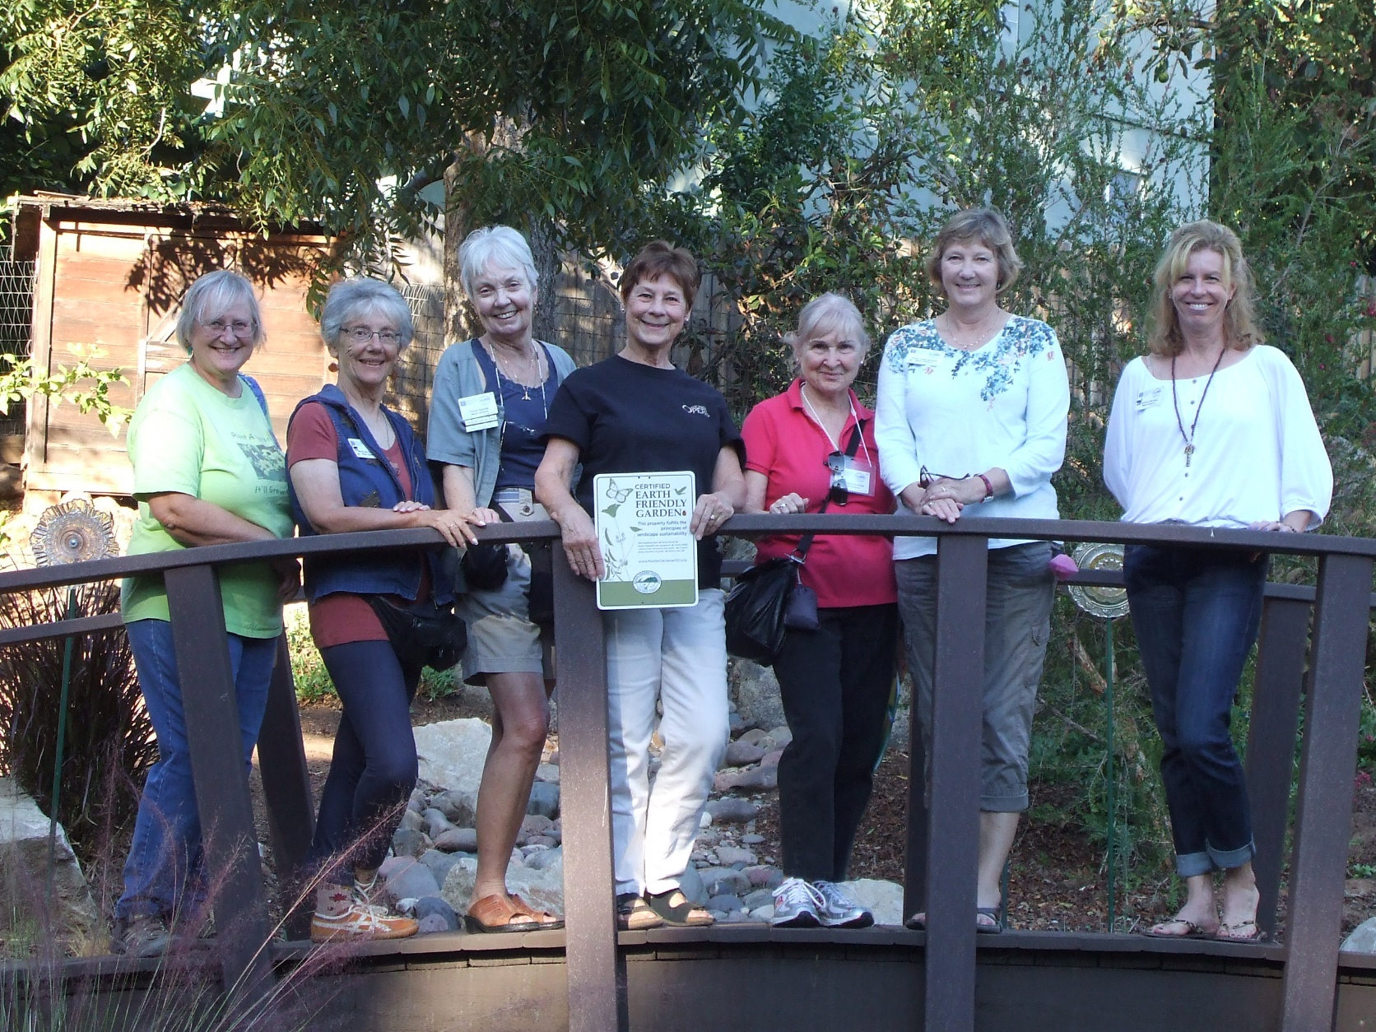
Revive Earth-Friendly Garden Visit program?

Slide 14
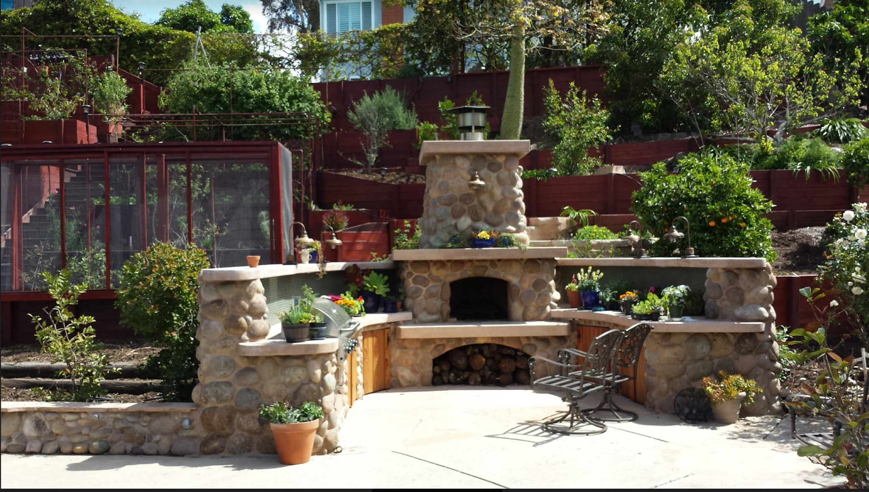
Meeting in June in Dawn’s Garden

Slide 15
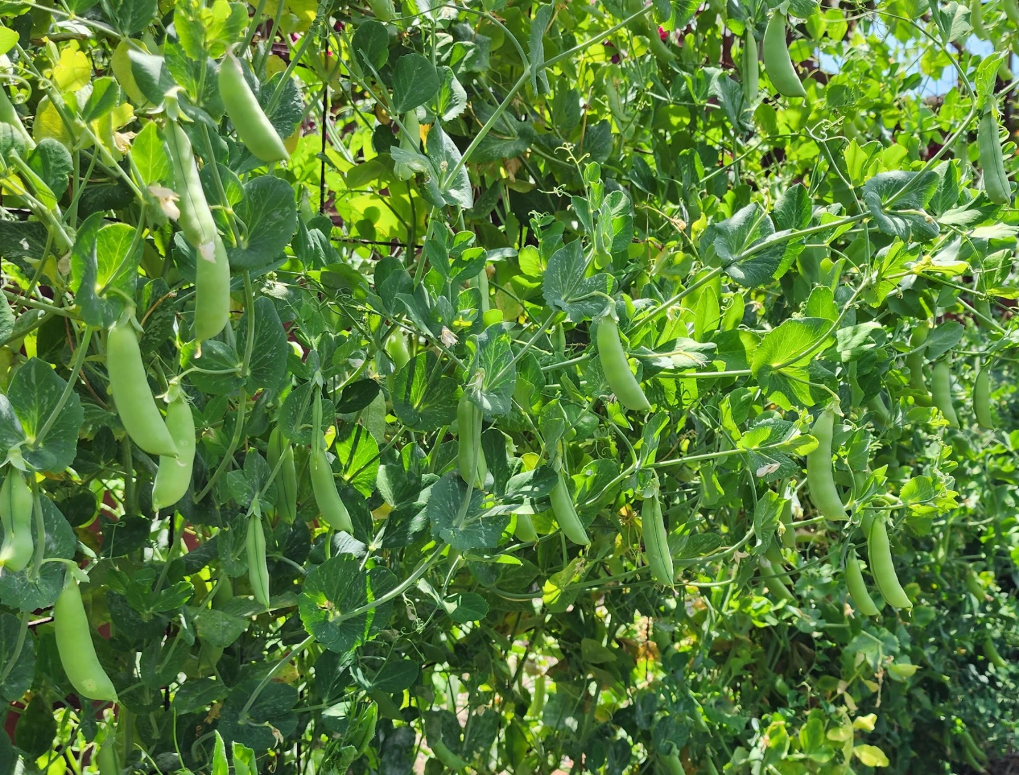
Please take some peas!!!

