Slide 1
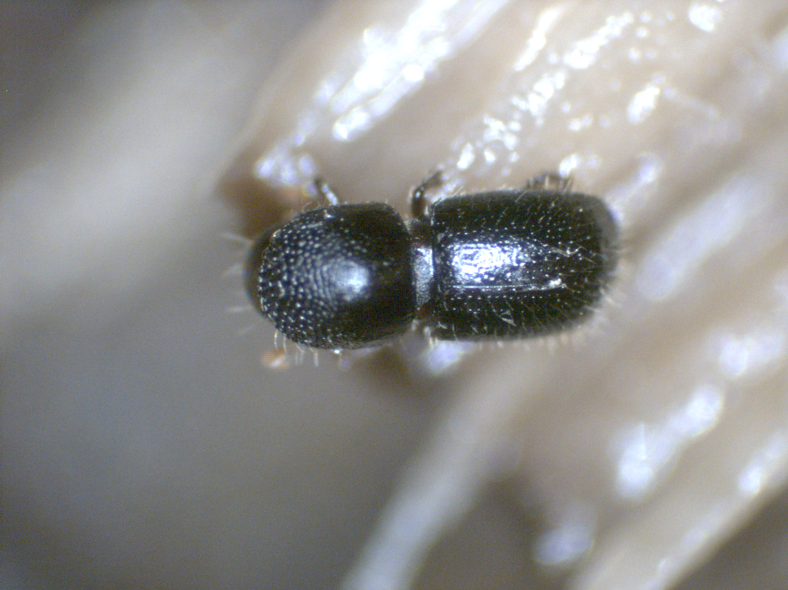

Slide 2
The good, the bad and the bugly
4/18/23

Slide 3
POLYPHAGOUS SHOT HOLE BORER (PSHB,Euwallacea sp.) Kuroshio shothole borer (KSHB)
And Fusarium Dieback (FD)
ISHB was first discovered in Los Angeles in 2012 and has now spread to Orange, San Diego, Riverside, San Bernardino, Ventura, Santa Barbara, and San Luis Obispo Counties.
Fusarium dieback disease vectored by the polyphagous shot hole borer is rapidly spreading
female

Slide 4
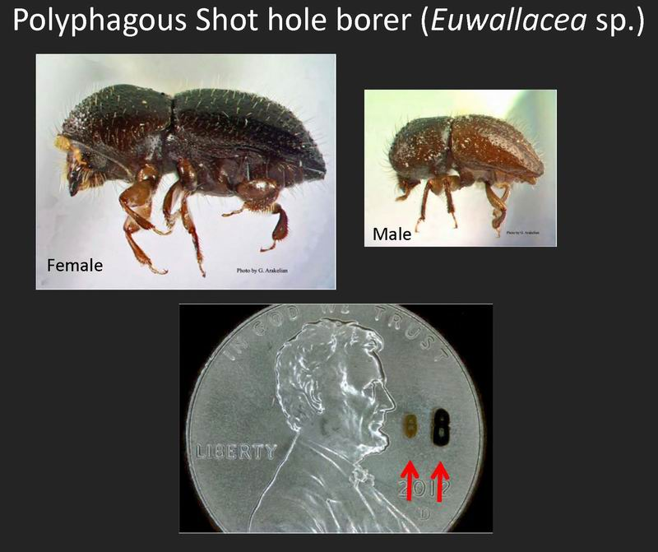
ISHB

Slide 5
IOLYPHAGOUS SHOT HOLE BORER
Pest in Southern California.
Known as ambrosia beetles
Boring beetle that drills into trees and brings with it a fungus (Fusarium sp.).
The ISHB attacks many species of trees, but many species are resistant to the fungus it carries.
The beetle is dark brown to black and tiny, with females between 0.07 and 0.1 inches long, and males even smaller, usually about 0.05 inches long.

Slide 6
What do they do?
Pregnant females bore through the tree’s bark, creating galleries under the bark. They plant the fungus in these galleries, where it grows and spreads throughout a susceptible tree.
The female then lays her eggs in these galleries and when the eggs hatch, the larvae eat the fungus.
The larvae develop into adults in about a month.
Many more of the larvae develop into females than males, and the females mate with the males (their brothers) while still in the gallery.
The pregnant females then pick up some of the fungus in their mouths, and leave through the entry holes created by their mothers to start the process again

Slide 7
When the polyphagous shot hole borer burrows into a tree, it inoculates the tree with a fungus, which, in turn, attacks the vascular tissue of the tree, blocking the transport
of water and nutrients from the roots to the rest of the tree.
PHOTO CREDIT: ESKALEN LAB, UC RIVERSIDE.

Slide 8
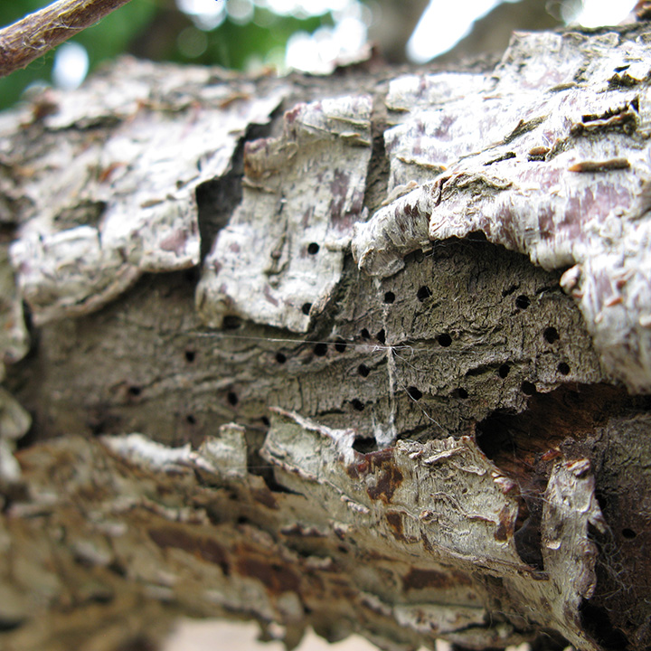
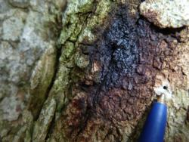
What to look for:

Slide 9
A selective list of 66 host trees:
Susceptible to ISHB-FD (may cause tree death)
Acer buergerianum - Trident maple
Acer macrophyllum - Big leaf maple*
Acer negundo - Box elder*
Parkinsonia aculeata - Palo verde
Platanus racemosa - California sycamore*
Platanus x hispanica - London plane
Populus fremontii - Fremont cottonwood*
Populus nigra - Black poplar*
Populus trichocarpa - Black cottonwood*
Quercus lobata - Valley oak*
Quercus robur - English oak
Ricinus communis - Castorbean
Salix gooddingii - Black willow*
Salix laevigata - Red willow*
Salix lasiolepis - Arroyo willow*
* Indicates CA native

Slide 10
Less susceptible to ISHB/FD (causes branch dieback), and/or the beetle commonly colonizes at the margin of canker diseases.
Acacia melanoxylon - Australian blackwood
Acacia spp. - Acacia
Acer paxii - Evergreen maple
Acer palmatum - Japanese maple
Acer saccharinum - Silver leaf maple
Aesculus californica - California buckeye*
Ailanthus altissima - Tree of heaven
Albizia julibrissin - Mimosa
Alectryon excelsus - Titoki
Alnus rhombifolia - White alder*
Archontophoenix cunninghamiana - King palm
Baccharis salicifolia - Mule fat*
Bauhinia variegata - Purple orchid tree
Brachychiton populneus - Kurrajong
Camellia semiserrata - Camellia
Castanospermum australe - Moreton Bay chestnut
Casuarina equisetifolia - Australian pine tree
Cocculus laurifolius - Laurel leaf snailseed tree
Corymbia ficifolia - Red flowering gum
Cupaniopsis anacardioides - Carrotwood
Dombeya cacuminum - Strawberry tree
Erythrina caffra - Coast coral tree
Erythrina coralloides - Coral tree
Ficus altissima - Council tree
Ficus carica - Black mission fig
Gleditsia triacanthos - Honey locust
Harpullia pendula - Tulip wood
Howea forsteriana - Kentia palm
Ilex cornuta - Chinese holly
Jacaranda mimosifolia - Jacaranda
Koelreuteria bipinnata - Chinese flame tree
Liquidambar styriciflua - American sweet gum
Magnolia grandiflora - Southern magnolia
Magnolia virginiana - Sweet bay
Parkinsonia florida - Blue palo verde*
Parkinsonia x sonorae - Sonoran palo verde
Persea americana - Avocado
Platanus mexicana - Mexican sycamore
Prosopis articulata - Mesquite*
Pterocarya stenoptera - Chinese wingnut
Quercus agrifolia - Coast live oak*
Quercus chrysolepis - Canyon live oak*
Quercus engelmannii - Englemann oak*
Quercus suber - Cork oak
Salix babylonica - Weeping willow
Spathodea campanulata - African tulip tree
Tamarix ramosissima - Tamarisk
Wisteria floribunda - Japanese wisteria
Xylosma congesta - Dense logwood / Shiny Xylosma
Erythrina falcata - Brazilian coral tree
Fagus crenata - Japanese beech

Slide 11
What Happens?
There are several potential outcomes of a beetle attack.
Beetle is repelled with no infection. This has been observed in 20 species of trees. Investigators are trying to figure out what features of the tree might repel the beetle.
Beetle drills into the tree and transmits the fungus, but doesn’t produce offspring. This has been observed in over 50% of the tree species attacked. We don’t know the final outcome of this interaction. Often leakage of xylem fluid is noticed on the trunk and branches. Maybe nothing bad will happen to the tree, but the tree could suffer if the xylem vessels are clogged up, which could cause dieback of branches. Damage could also make the tree more prone to attack from other pest species.
Beetle drills into the tree, fungus infects the tree, and the beetle produces offspring in the tree. This has been seen in about 8% of the tree species attacked, and these species are considered true host of PSHB, and include box elder, coast live oak, and avocado. Interestingly from a natural resources perspective, it also includes invasive plants like castor bean and tree of heaven (Ailanthus). Some trees seem to suffer mild symptoms like branch die-back, while others are killed outright.

Slide 12
How to confirm PSHB/FD:
Look for a single entry/exit hole surrounded by wet discoloration of the outer bark, or gumming, staining, white powdery exudate and frass.
Scrape off the bark layer around the infected area to look for brown discolored necrosis caused by the fungus.
Follow the gallery to look for the beetle (may or may not be present).
Look for other hosts (castor bean, sycamore, maple, coast live oak, goldenrain) showing symptoms of the beetle/disease.
Sterilize tools to prevent to spread of the disease with either 25 percent household bleach, Lysol® cleaning solution, or 70 percent ethyl alcohol.

Slide 13
What can you do?
Keep your trees healthy. Proper irrigation and maintenance will keep trees strong and help protect them from ISHB and other pests. Prevention of sunburn can be key in many species.
Check your trees. Look for the common signs and symptoms listed previously. Regular monitoring ensures that infestations are managed early, before they cause dieback or death.
Confirm suspected infestations. Use the online ISHB Detection and Management tool to confirm your observations.
Review your management options. When possible, pruning infested branches is recommended. Low and moderately infested trees can be treated (you’ll need to contact a licensed professional to apply the treatments). Severely infested trees may require removal since they are not likely to recover and are a constant source of beetles that can spread and infest neighboring trees.

Slide 14
5. Call in a professional. A certified arborist or pest control professional would be able to provide recommendations based on the conditions of your tree. Your county Agricultural Commissioner’s Office and UC Cooperative Extension office may have additional knowledge about current ISHB monitoring and management programs in your area.
6. Take care of green waste. The beetles can survive in cut wood for weeks or even months. Proper disposal of green waste includes chipping infested wood, followed by solarizing or composting the chips.
7. Don’t move firewood. These beetles and other tree-killing insects often reach new locations by hitchhiking in firewood. Please use locally sourced firewood to help slow the spread of non-native pests like the invasive shothole borers. Buy firewood where you will use it, and only purchase the amount of firewood you need. Do not move unburned firewood.
8. www.ISHB.org Visit the ISHB website to access the ISHB Detection and Management Assessment tool, find your local UC Cooperative Extension office and Agricultural Commissioner’s Office, and get more information on ways to safely dispose of green waste.

Slide 16
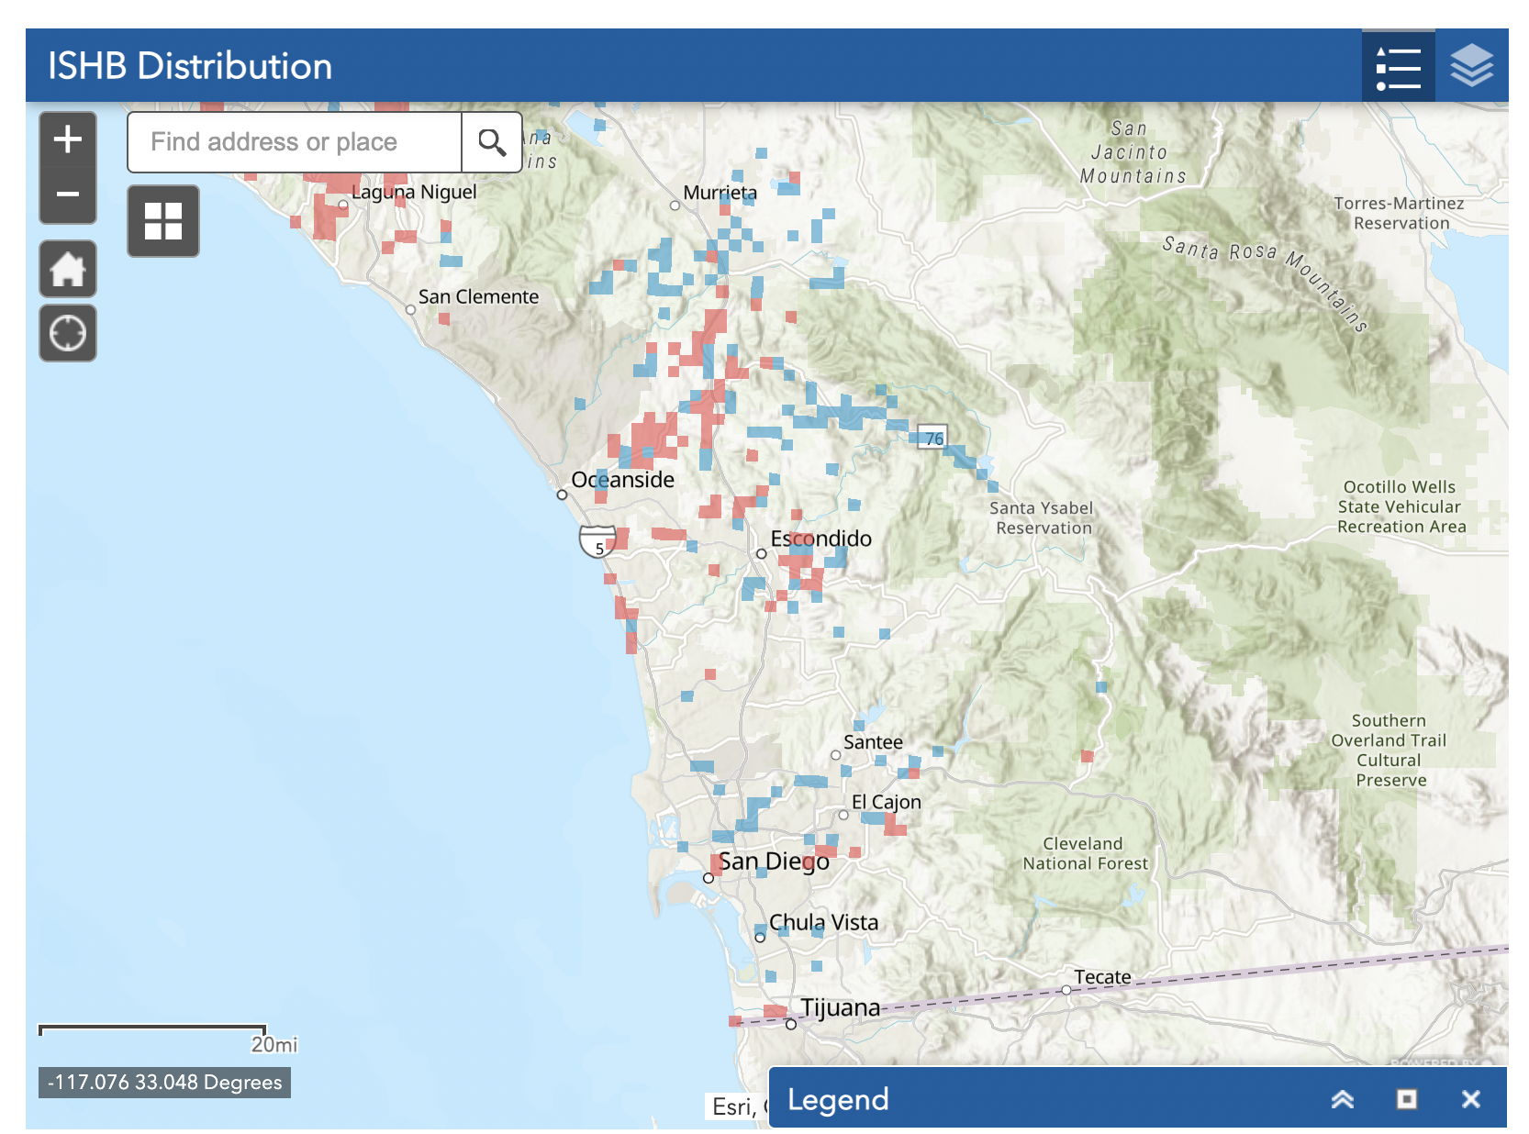
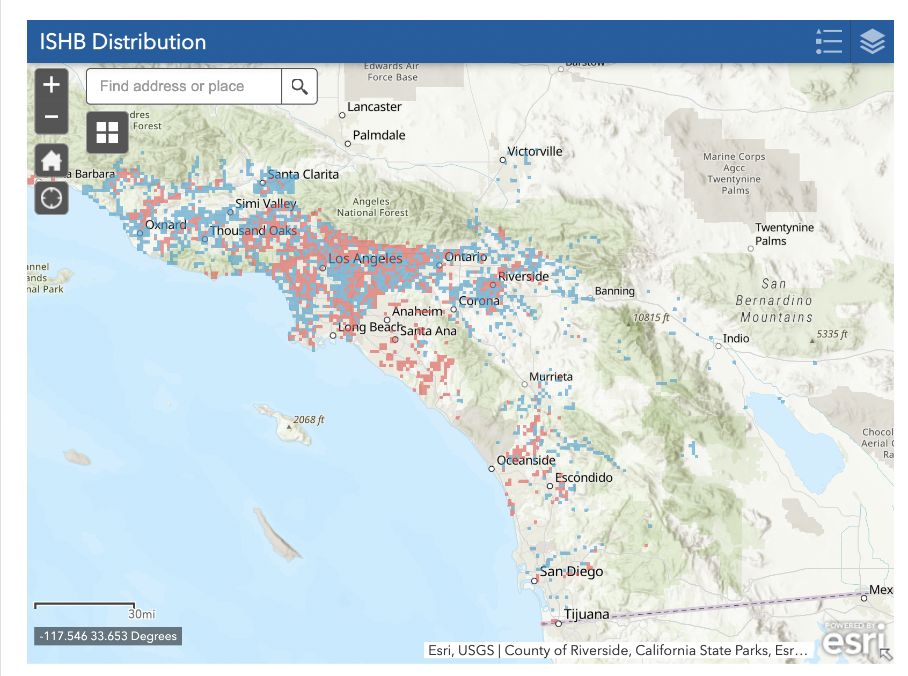
2023
Red: Positive Square Mile

Slide 17
Resources
Great Video: https://www.youtube.com/watch?v=SZwRq2hqOWA
https://ucanr.edu/sites/pshb/resources/handouts/
http://www.iscc.ca.gov/docs/ISHB_Final_Report0909019.pdf
https://ipm.ucanr.edu/agriculture/peach/shothole-borer/#:~:text=Shothole%20borers%20are%20tiny%20brown,angles%20to%20the%20egg%20gallery.
https://ucanr.edu/sites/pshb/pest-overview/
https://ucanr.edu/sites/pshb/pest-overview/ishb-reproductive-hosts/

