Slide 1
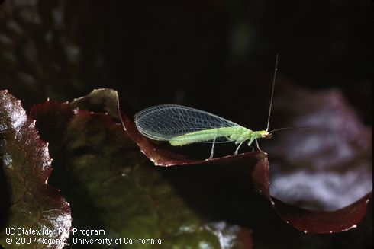

Slide 2
The Good, The Bad... And the Bugly!
Some Common Insects to Know
UC MGP SDC – Class of 2023
3/14/2023

Slide 3
Green Lacewing
Chrysoperla carnea

Slide 4
Scientific Classification
Phylum: Arthropoda
Class: Insecta
Order: Neuroptera
Family: Chrysopidae
Genus and species:
Chrysoperia spp.
(in CA: Chrysopa spp., Chrysoperla spp., Eremochrysa spp., Meleoma spp., other Chrysopidae)
Complete metamorphosis (four life stages) egg, larva, pupa, and adult.
19mm (3/4”) excluding antennae
37 species, 11 genera in CA
Notes:
Green lacewings develop though 4 stages: egg, larva, pupa, and adult. The adult female lays about 100 to 300 eggs during her several-week lifespan. After hatching, larvae develop through 3, increasingly larger instars before pupating on plant surfaces or under loose bark.
All stages can occur throughout the year in locations without cold winters. Adults become less active and may stop laying eggs and change coloration during late fall through winter. Especially in locations with cold winters, overwintering is mostly as inactive last instars (prepupae) or pupae within silken cocoons in bark crevices or other protected locations.
Green lacewings commonly have several generations per year. Egg to adult development requires about 4 to 6 weeks when temperatures are warm.
Species
At least 37 species of green lacewings in 11 genera occur in California. These include Ceraeochrysa, Chrysopa, Kymachrysa, Pseudomallada, and Yumachrysa spp. and 7 or more species each of Chrysoperla, Eremochrysa, and Meleoma.

Slide 5
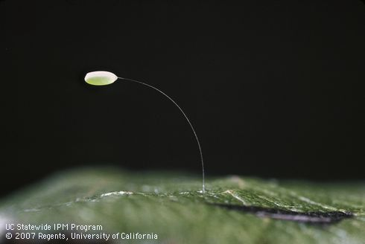
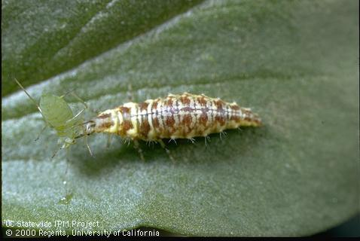
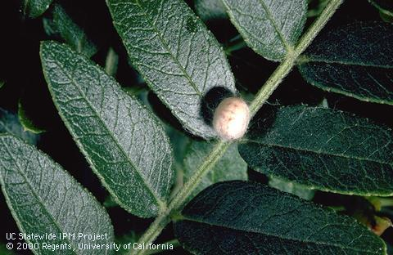
Identification
Adults: ¾” inch long
4 wings held rooflike over the body
Commonly green, but can be
red/brown in fall
Eggs: 1/16” inch or less
Individually laid egg at the end of silken thread
Pale-yellow-green or white when laid
Gray when ready to hatch
Larvae: 1/2” inch long or less
Flattened body, distinct legs
Look like tiny alligators
Promient, paired, tubelike mouthparts
Pupae: 1/8 to ¼” in diameter
Roundish, loosely woven, whitish
Curled body visible
©UC IPM
Notes:
Adults are soft-bodied insects with golden eyes and 4 membranous wings held rooflike over the body at rest. The wings and body are commonly green. Adults (head to wing tip, excluding antennae) average about 3/4 inch (19 mm).
Eggs are oblong and 1/16 inch (1.5 mm) or less in length. Each is laid on the end of a silken stalk attached to plants. Eggs are pale yellowish-green or white when laid, then change to bluish-green and finally gray before hatching.
Larvae are elongate and flattened with distinct legs and resemble tiny alligators. The body is about 1/2 inch long or less and commonly cream, tan, or yellowish with lengthwise lines or rows of spots that are blackish, dark or light brown, or reddish. Larvae have prominent, paired, tubelike mouthparts that curve inwards.
Pupae occur in a roundish cocoon about 1/8 to 1/4 inch (3–6 mm) in diameter. The curled body is commonly visible through the loosely woven, whitish silk.

Slide 6
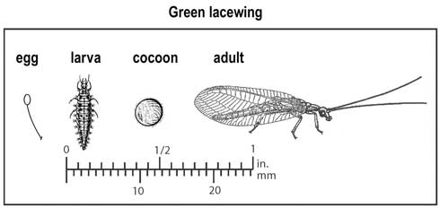
Notes:
Green lacewings occur in field and tree crops, gardens and landscapes, and wildlands. Adults feed on honeydew, plant nectar, and yeasts; some additionally are predaceous (e.g., Chrysopa species) while others are not (Chrysoperla species).

Slide 7
Hosts (or Prey)
Mites and soft-bodied insects
Aphids
Caterpillars
Lace bugs
Leafhoppers
Mealybugs
Psyllids
Scales
Thrips
Porch lights
Notes:
Lacewings are considered beneficial predators, eating many pest insects that do damage to cultivated garden plants. Whiteflies is another prey species
There are several species of green lacewings; some species have predaceous adults, while others feed only on honeydew, nectar and pollen. Larvae look like tiny alligators and are generalist predators on mites and small insects, including aphids, caterpillars, leafhoppers, mealybugs, psyllids, thrips, whiteflies, and insect eggs.

Slide 8
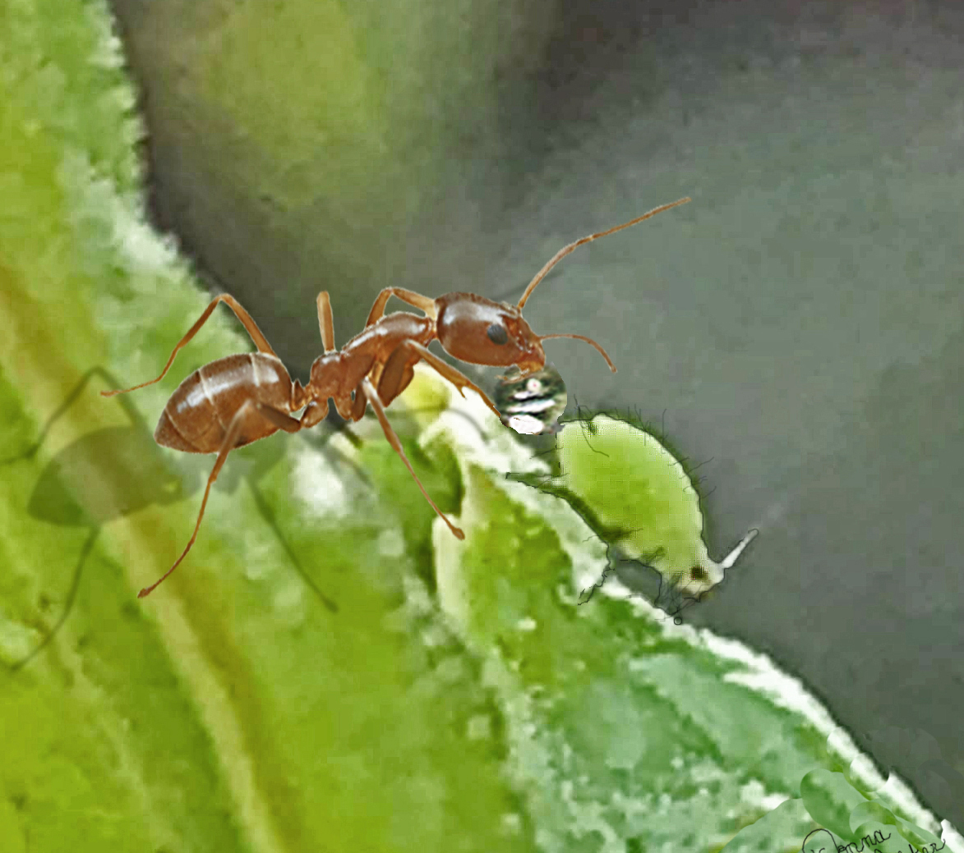
Management? Or let’s say, protect those natural predators!
Protect lacewings and other beneficial predators in the garden by avoiding using certain pesticides that can kill them, and choosing plants that provide pollen, nectar, and shelter. You'll also want to keep ants out of pest-infested plants.
Notes:
The Sterile Insect Technique is used in maintaining a fly-free zone in Mexico, Texas and California. Technology for the eradication programs used to maintain these zones is supported by research by the USDA-ARS laboratory in Weslaco, Texas, and Sanidad Vegetal laboratories in Mexico. Both research groups cooperate with USAD-APHIS Plant Protection and Quarantine and International Services departments in establishing protocols and executing sterile insect release programs.

Slide 9
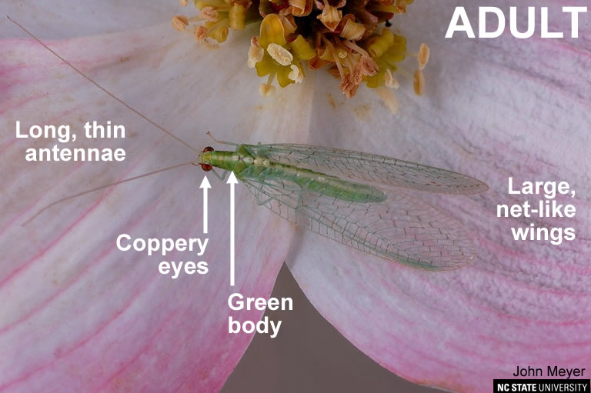
So…
”Good” or “Bad”

Slide 10
Resources
https://www.discoverlife.org/mp/20q?search=Chrysopidae
https://ucanr.edu/blogs/blogcore/postdetail.cfm?postnum=24151
https://ipm.ucanr.edu/natural-enemies/green-lacewings/#:~:text=Green%20lacewings%20occur%20in%20field,and%20suck%20the%20body%20contents
https://ipm.ucanr.edu/QT/beneficialpredatorscard.html

